Slide 1
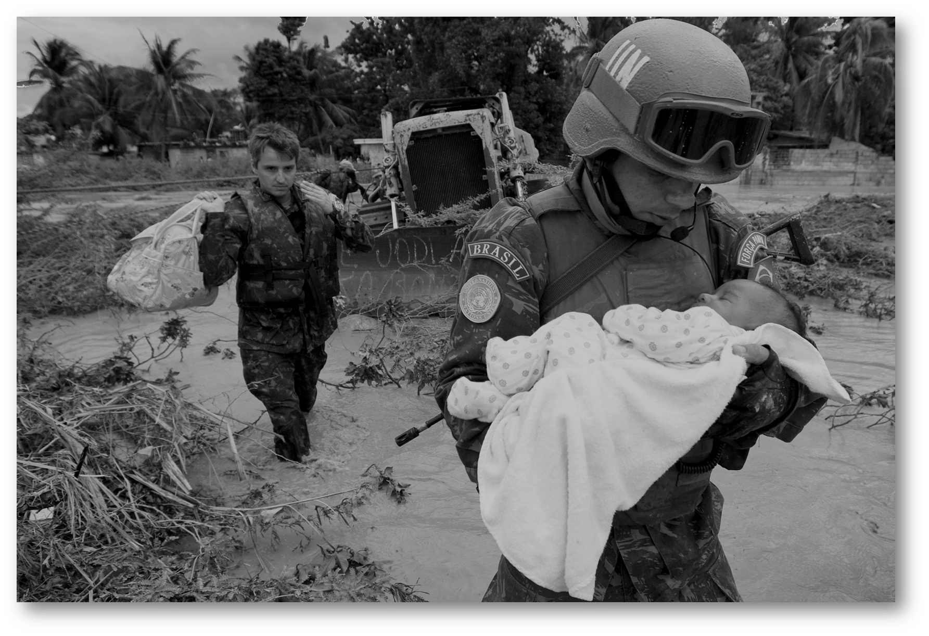

Police
Secondment Campaign
How to prepare the submission
Serving the World
1

Slide 2
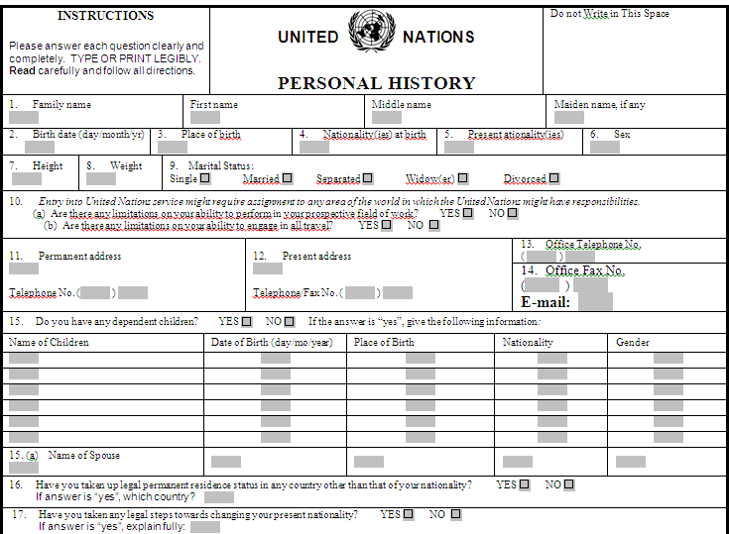
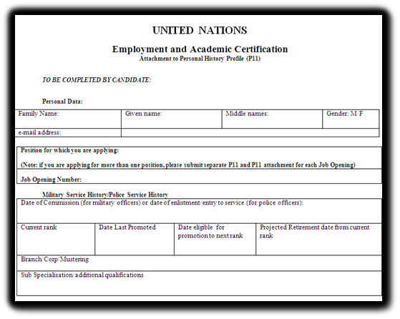
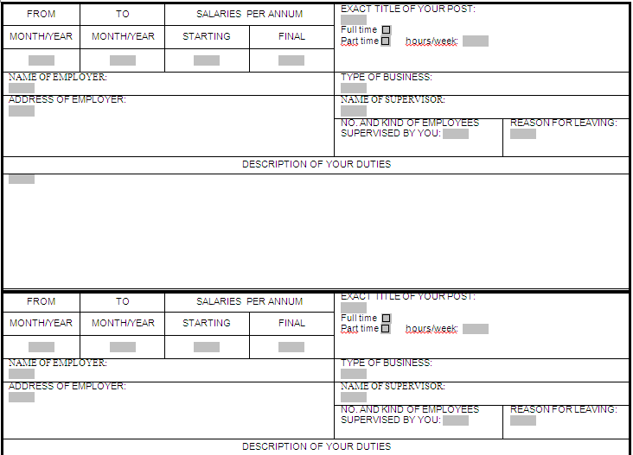
What Forms Nominees Should Submit?
Each nominee should complete the following 3 forms:
United Nations Personal History Profile (PHP), P-11
Employment Record (Supplementary Sheet), if needed
Employment and Academic Certification (Attachment Form to P-11)
1
3
2

Slide 3
Before filling the forms…
Candidates are strongly encouraged to review and understand the functions and responsibilities of the position/s to which they are applying as well as the qualifications necessary. By doing so, candidates will:
Improve their ability to position themselves to meet the needs of the hiring office;
Save time and reduce frustration that results from applying to jobs which do not match their strengths, aspirations and personal circumstances.
3

Slide 4
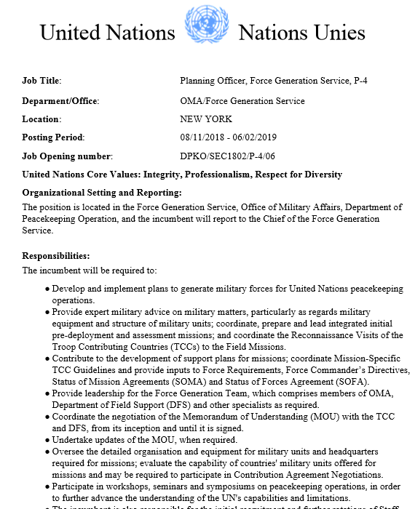
Understanding the Job Opening (JO)
All JOs are organized in the following 5 sections:
Title
Organizational Setting and Reporting
Responsibilities/functions
Competencies
Professionalism
Planning and Organizing
Teamwork
Communication (for P-4 and above), when applicable
Qualifications:
Education
Experience
Languages
Assessment Methods
Written Test
Competency Based Interview
4

Slide 5
Form 1: UN Personal History Profile (PHP), P-11
Each nominated candidate must complete and sign the UN Personal History Profile (PHP), P-11
NOTE:
Incomplete and unsigned P-11 forms
will not be accepted
5

Slide 6
Form 1: UN Personal History Profile (PHP), P-11cont.
Information requested from the nominees
Personal Information
Education and Publications
Employment History – in detail in the next slide
Languages
References
6

Slide 7
Employment History
Form 1: UN Personal History Profile (PHP), P-11cont.
Description of Duties
Duties:
What is done in current job
Describe responsibilities with careful attention to the job opening for which you are applying
Use of Grammar
Current job: present tense
Past job (s): past tense
Summary of Achievements
Achievements:
How well performed in the job
Provide specific examples where an impact or contribution was made in the positions held
7
Notes:
The Personal History Profile will be used to evaluate the candidate’s eligibility and suitability for the job opening,
therefore, it is suggested that candidate:
• Highlight the salient points in his/her background in relation to the job opening of interest.
• It is important to complete all information about your education and work experience accurately. This information will be used to pre-screen and short-list.
• When completing the work experience, candidates should list every position held and not only the most recent or what is required for the position.
• When completing the education details, candidates should ensure to include all institutions, listing clearly those academic credentials (degrees, certificates and diplomas) conferred.

Slide 8
Additional Tips
Form 1: UN Personal History Profile (PHP), P-11cont.
The UN will first know a candidate through their application/PHP
Candidates should:
be truthful, accurate and specific
make words count
proofread before finalizing/signing
8
Notes:
Candidates should
BE CONSICE
Make the words count. The use of language is extremely important; candidates need to project themselves efficiently. Address the job's needs with clearly written, powerful phrases. Provide small, digestible pieces of information. Use action verbs. Avoid passive sentence constructions Avoid clichés
MAKE THE MOST OF THE EXPERIENCE
Recruiters need to know what the candidate has accomplished to have an idea of what s/he can do for the Organization. Do not be vague. Especially in the achievements section, candidates should focus on what they have accomplished and achieved, as opposed to what they do on a daily basis. Candidates must be honest. There is a difference between making the most of their experience and exaggerating or falsifying it.
TARGET, TARGET, TARGET
Candidates need to be specific. If applying to more than one job opening, candidates should customize their application accordingly.

Slide 9
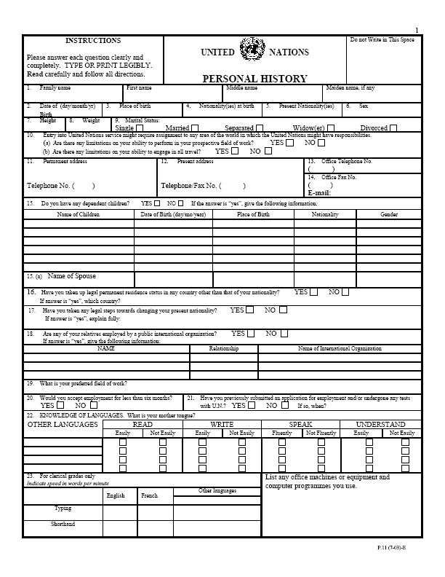
Sample
Form 1: UN Personal History Profile (PHP), P-11cont.

Slide 10
Form 2: Employment Record Form (Supplementary Sheet)
The supplementary sheet should be used to include additional working experience
If applicable, for each candidate nominated for a post, a duly completed and signed employment record form (supplementary sheet) may be required
10

Slide 11
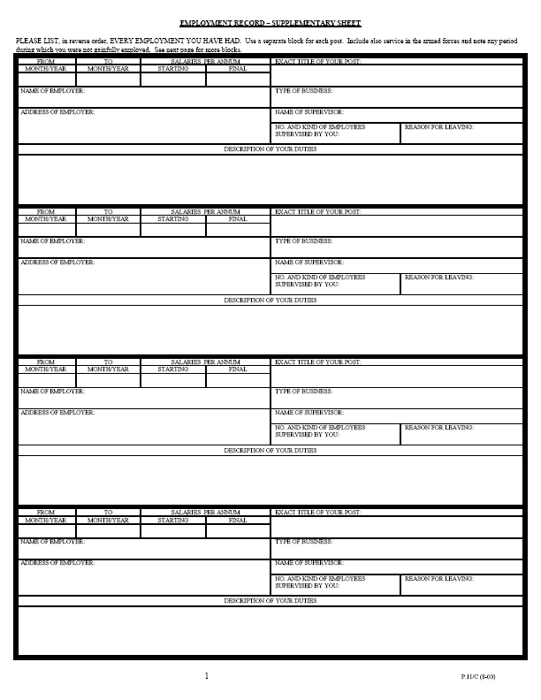
Sample
Form 2: Employment Record Form (Supplementary Sheet)

Slide 12
Form 3: Employment and Academic Certification (Attachment to P-11)
For each nominated candidate for a post, a duly completed Employment and Academic Certification form (Attachment to P-11) must be signed by the candidate and stamped by the relevant local police authority.
NOTE:
Incomplete, unsigned, and unstamped forms
will not be accepted
The Certification must contain details on the candidate’s police academic degree/courses and employment record as well as his/her rank and date of enlistment/entry to service for police officers.
12

Slide 13
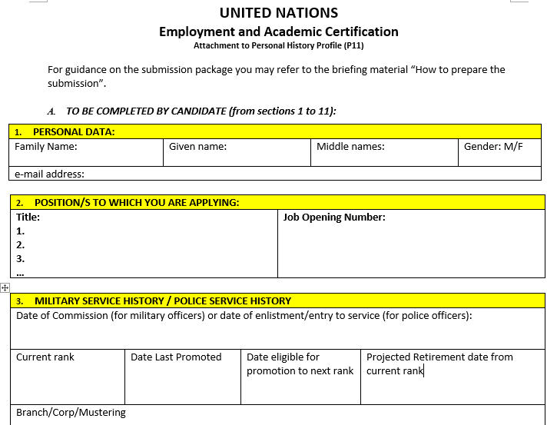
Sample
Form 3: Employment and Academic Certification (Attachment to P-11)

Slide 14
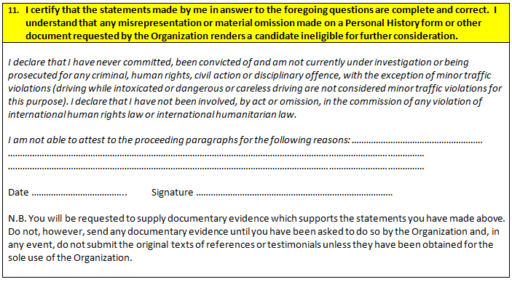
Form 3: Employment and Academic Certification (Attachment to P-11)
Part to be signed by candidate - Sample (continuation)

Slide 15
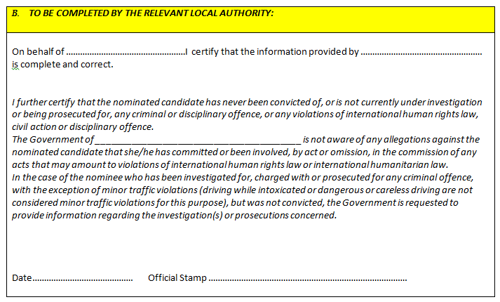
Form 3: Academic and Employment Certification (Attachment to P-11)
Part to be filled and stamped by the relevant authority - Sample (continuation)

