Slide 1
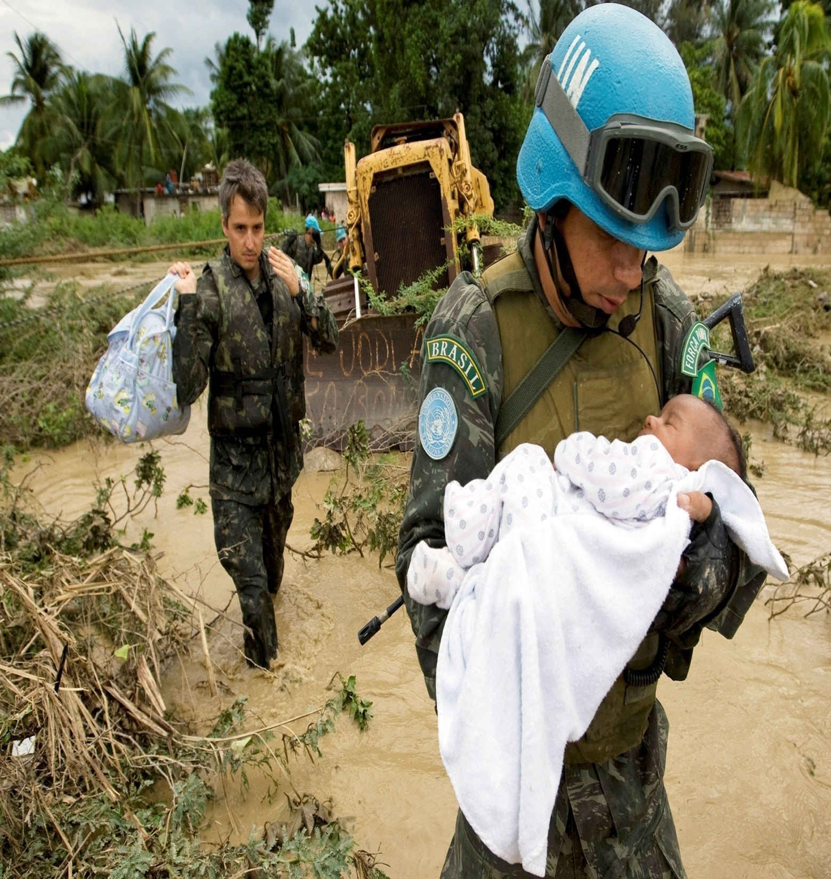

Competency
Based
Interviews
For
Police
Secondment
Campaign

Slide 2
Agenda
Values and Competencies
Why Competency-based Interview
The CAR(L) Principle
How to Prepare for an Interview (Do’s and Don’ts)
Exercises (Teamwork, Planning & Organization)
Additional resources

Slide 3
Values and Competencies
Values:
  Shared principles and beliefs that underpin the organization’s work and guide actions and behaviours of staff
Competencies:
  Skills, attributes and behaviours directly related to successful job performance

Slide 4
Values and Competencies
(continued)
Core Values | Core Competencies | Managerial Competencies
Integrity Professionalism Respect for Diversity | Communication Teamwork Planning and Organizing Accountability Creativity Client Orientation Commitment to Continuous Learning Technological Awareness | Vision Leadership Empowering Others Managing Performance Building Trust Judgement and Decision-making

Slide 5
Why competency-based interviews (CBI)?
Competencies are forward-looking; they describe skills and attributes that staff and managers need to build human capital and meet future challenges
Competencies help organizations clarify expectations and define future development needs
CBI questions ask about past professional experiences that can demonstrate that the applicant is competent
The theory is that if you can demonstrate that you have done it in the past or have learned from the past, chances are that you will be able to do it in the future
When assessing the applicants’ responses, panels will ascertain the depth and complexity of the responses given by applicants
CBI is sometimes referred to as behavioral or situational interviewing
Notes:
The United Nations' greatest asset is the quality of its staff. To ensure that the very best people join the UN team we use a competency based interview process. Competency based interviews are also called "behavioral interviews" or "criterion based interviews." Such interviews are based on the concept that past behavior and experience is the best indicator of future performance. In other words, your history tells a story about you: your talents, skills, abilities, knowledge and actual experience in handling a variety of situations.

Slide 6
CAR (L) Principle
Context:
  You will be expected to give an overview of the situation: what the situation was about, how you first got involved, what were the key events and the time frame
Actions
  You will be expected to cover significant events, specific instances, that were clearly attributable to you rather than the team
Results
  What was the outcome, impact or results of your actions: You may be asked questions such as “how did it turn out”? “What was the final result?”
Learning
  What did you learn from this experience?

Slide 7
Prepare for the interview
Preparing for the interview:
  Learn as much as you can about the organization (mandate, publications, organigrame, strategic directions, news, etc.)
  understand the position and look at the competencies in the job opening
  review the application/PHP and select real examples matching their accomplishments to the competencies (i.e. how did they work in a team, solve conflict, mobilize resources, etc.)
  Practice, practice, practice beforehand (refer to your application and the requirements of the job opening)
Notes:
Useful tips for your interview:
Prepare a wide range of brief real life stories about your accomplishments. Be aware of the specific skills each story illustrates and remember to include the positive outcome or lesson learned from each experience.
Be ready to discuss your strengths and your ability to learn from past experiences. Also think about how you could contribute to the work of the United Nations and to the specific position you are applying for.
Review the competencies mentioned in the job opening. These will be probed in your interview, so your stories should show your skill in these competency areas.
You should be prepared to address positive results and achievements using these competencies and also challenges you have had in each of these areas.

Slide 8
During the interview: do
If invited to an interview:
  face-to face, body language, few suggestions:
    Dry firm hand shake at beginning and end of interview,
    Maintain eye contact,
    Replies should be concise and to the point and
    Overall just try to look and feel relaxed.
  telephone (or Skype/Teams) make sure you are in a private location and equipment is working
In both cases:
  Listen carefully to the complete question. Ask for clarification if a question is not clear
  Provide concrete examples that show you were able to handle a situation and/or learned from it

Slide 9
During the interview: do not
During the interviews candidates should not:
  Answer in the hypothetical way
  Talk about “we”, rather talk in the “I”
  Espouse theories or values (“waffling on”)
  Make blanket generalizations or statements about the future
  Interrupt the panel

Slide 10
Sample questions on
Teamwork
Describe to us a successful teamwork work experience
  What was the situation?
  What was your role?
  What made the team successful?
  How did you handle any disagreements within the team?
  What were the results?
  What did you learn from the experience? If you had to do it again what would you do differently?

Slide 11
Sample questions on
Planning and Organizing
Tell us about a time you had to organize or plan a major event
  What was the nature of the event?
  What was your role?
  How did you plan and organize the different actions to carry out?
  How did the event turn out?
  Reflecting back, what did you learn from the experience? If you had to do it again what would you do differently?

Slide 12
Sample questions on
Planning and Organizing
(continued)
Tell us about a time where you had several demands being made on you at the same time? How did you handle it?
  What was the situation?
  What was your role?
  How did you plan and organize the different actions to carry out?
  What were the results?
  What did you learn from the experience? If you had to do it again what would you do differently?

